Slide 1
Parallel Programming
Final Project
Group13 108032053 陳凱揚

Slide 2
Outline
Problem description
CPU - sequential
GPU - optimize step by step
Time distribution
Profiling

Slide 3
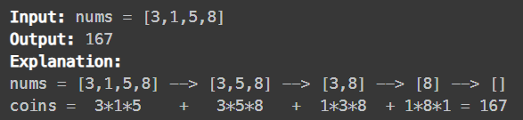
Problem description
Given n balloons. Each balloon is painted with a number on it represented by an array nums. You are asked to burst all the balloons.
If you burst the ith balloon, you will get nums[i-1]*nums[i]*nums[i+1] coins. If i-1 or i+1 goes out of bounds of the array, then treat it as if there is a balloon with a 1 painted on it.
Return the maximum coins you can collect by bursting the balloons wisely.
Constraints: 1 <= n <= 10000, 1 <= nums[i] <= 50.

Slide 4
CPU - sequential
Solved by dynamic programming.
Define state
dp[ i ][ j ] is the maximum coins you can collect after bursting all balloons in [ i + 1, j - 1 ] (not including i and j).
State transition equation
dp[ i ][ j ] = 0, if j - i + 1 = 2.
dp[ i ][ j ] = max{ dp[ i ][ k ]+dp[ k ][ j ]+nums[ i ]*nums[ k ]*nums[ j ] } for all k in [ i + 1, j - 1 ], if j - i + 1 > 2.
Answer: dp[ 0 ][ n - 1 ]
Time complexity: O(n³)

Slide 5
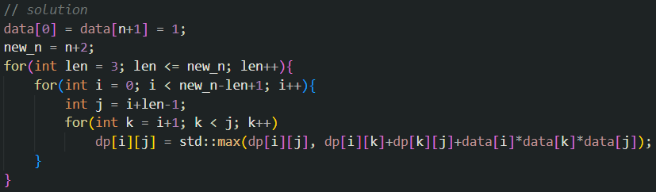
CPU - sequential

Slide 6
GPU - optimize step by step
Baseline (21.92s)
DP reindexing (7.57s)
Parallel maxreduce (6.82s)
Two data per thread (5.99s)
Multiple data per thread (4.07s)
Unroll last warp (3.93s)
Unroll all (3.90s)

Slide 7
Baseline (21.92s)
Store input data to the constant memory in the GPU because it is read only.
Parallel the second loop first because the first loop has dependency and the third loop should use atomicMax or perform max reduce operation, which will be optimized later.
The number of threads per block is fixed to 1024 (#define NT 1024).

Slide 8
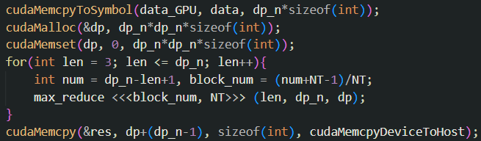
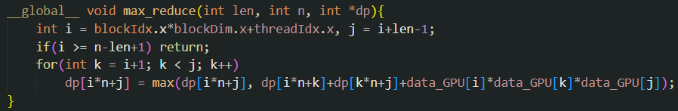
Baseline (21.92s)

Slide 9
DP reindexing (7.57s)
Change the index of DP because the first loop is according to the length of subarray.
Redefine state
dp[ len ][ left_idx ] is the maximum coins you can collect after bursting all balloons in [ left_idx + 1, (left_idx+len-1) - 1 ].
State transition equation stays the same.
Answer: dp[ n ][ 0 ]

Slide 10
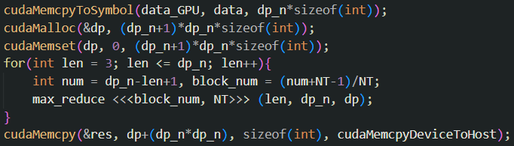
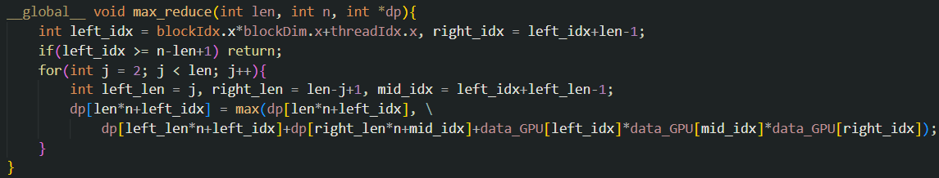
DP reindexing (7.57s)

Slide 11
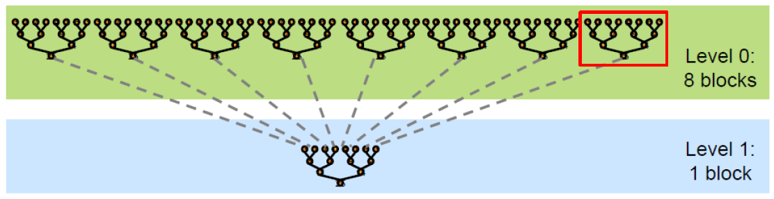
Parallel maxreduce (6.82s)
Use similar method from the NVIDIA slides which is mentioned in the class to parallel max reduce.
Use two dimensions block, the second dimension is the block of level.
Use an additional array to store reduced data.

Slide 12
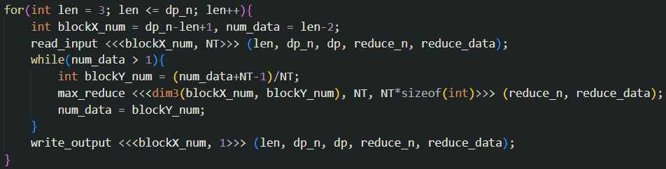
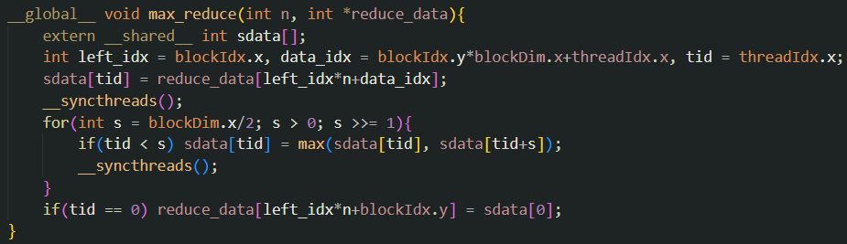
Parallel maxreduce (6.82s)

Slide 13
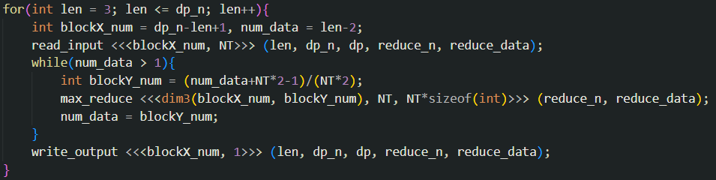
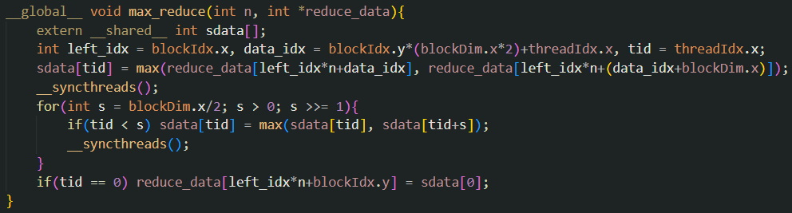
Two data per thread (5.99s)

Slide 14
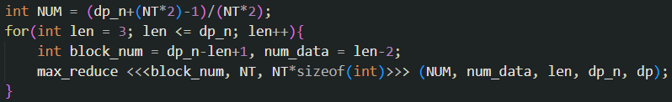
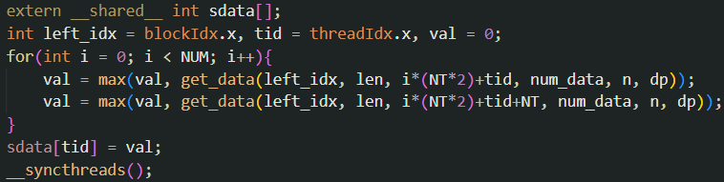
Multiple data per thread (4.07s)
Each thread loads NUM*2 data, so there are only 1 block in each layer.
The second dimension of block can be removed.
Shared memory is large enough to store all reduced data.

Slide 15
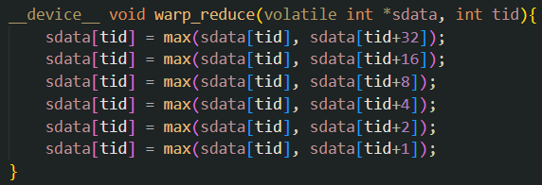
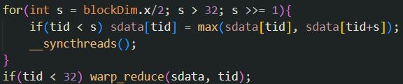
Unroll last warp (3.93s)
Use the same method from the NVIDIA slides to unroll last warp.
There are 32 threads per warp.
Instructions are SIMD synchronous within a warp

Slide 16
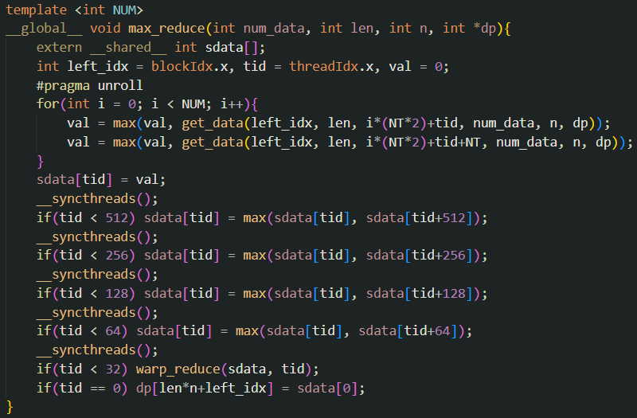
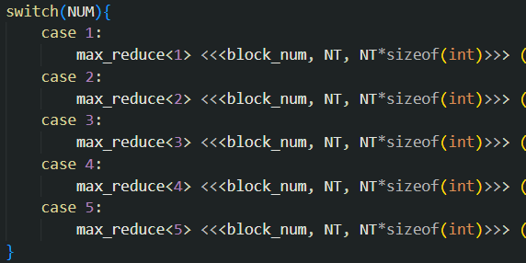
Unroll all (3.90s)
Use the same method from the NVIDIA slides to unroll all loop.
Use C++ template parameters

Slide 17
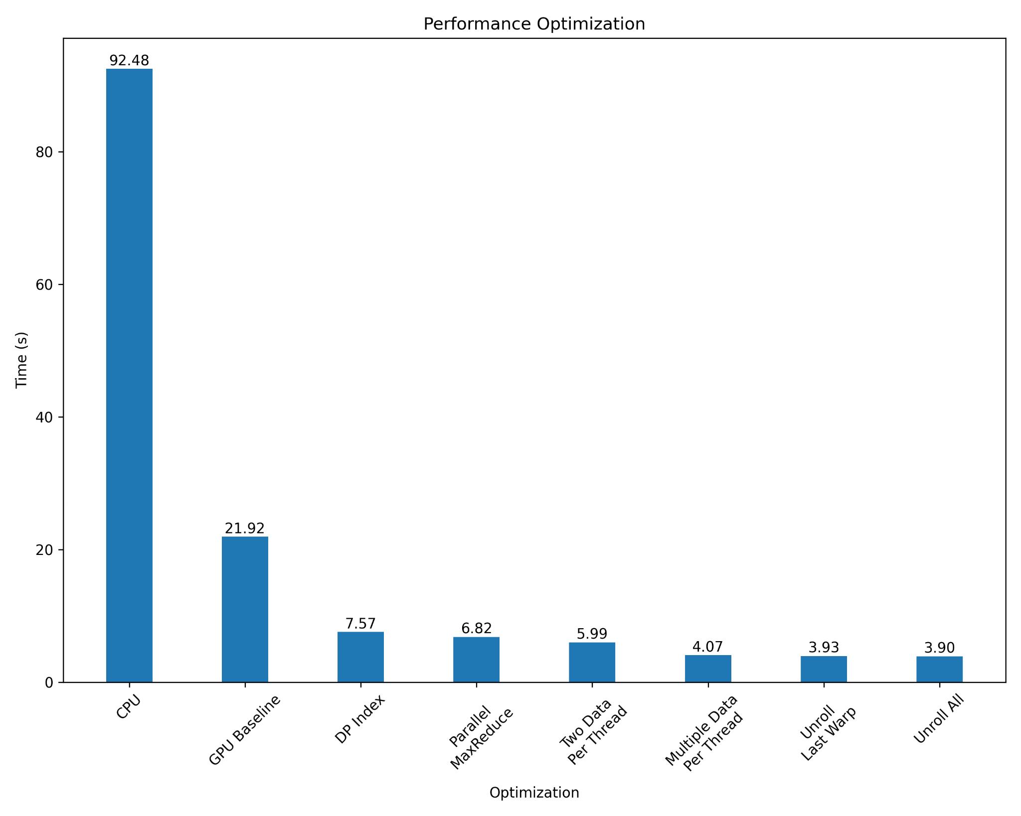
GPU - optimize step by step

Slide 18
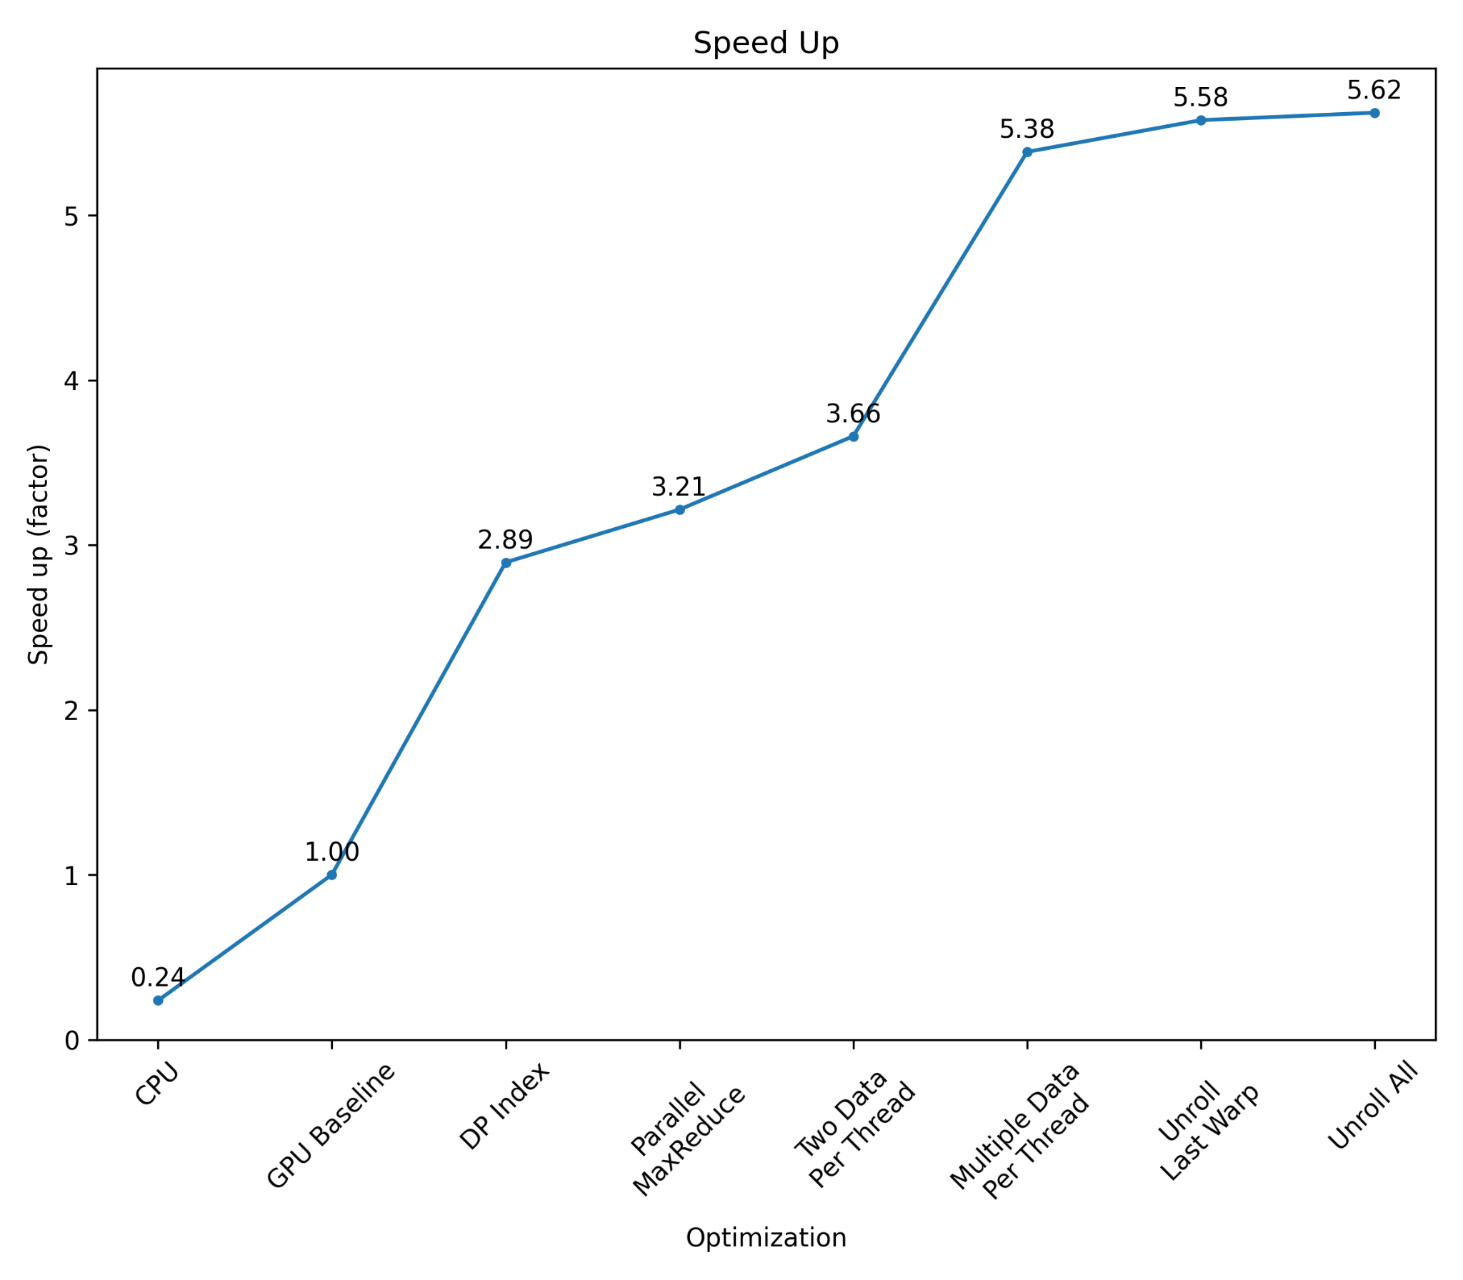
GPU - optimize step by step

Slide 19
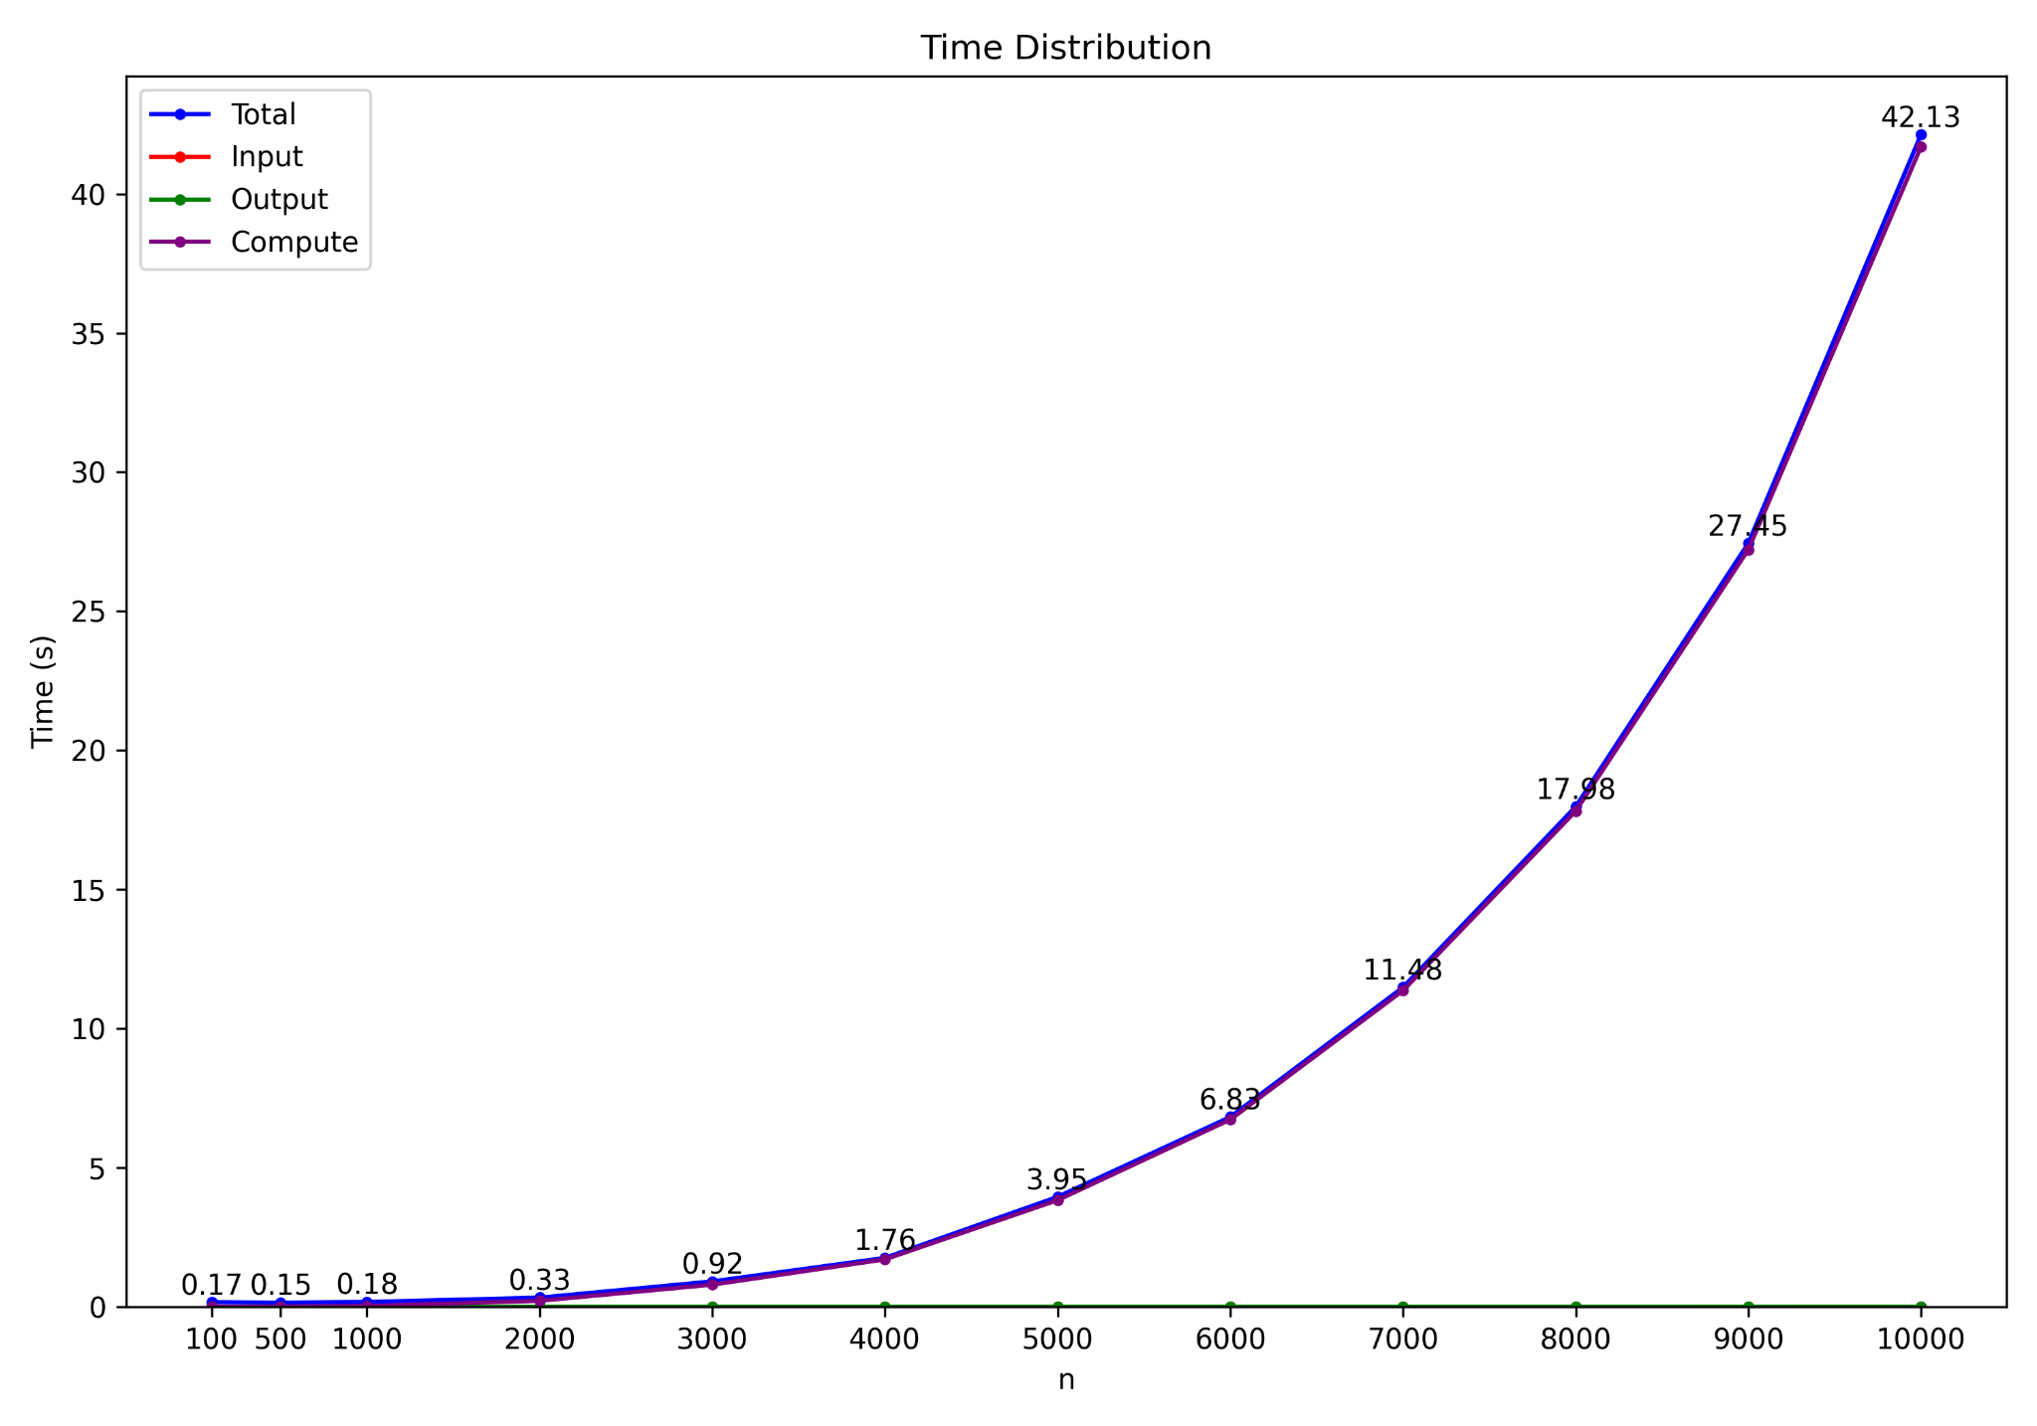
Time distribution

Slide 20
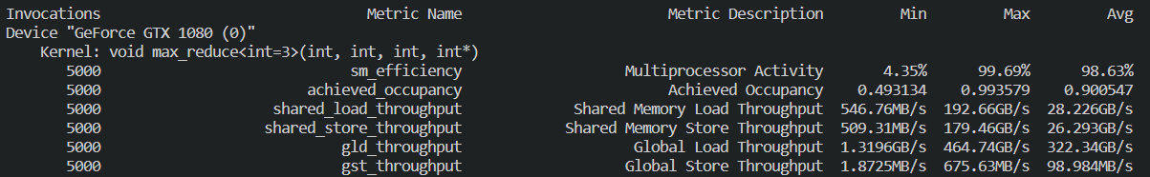
Profiling

Slide 21
Reference
https://leetcode.com/problems/burst-balloons/
https://developer.download.nvidia.com/compute/cuda/1.1-Beta/x86_website/projects/reduction/doc/reduction.pdf

